Slide 1


Slide 2

J. M. Imbong
Adobe® UGM
Senior Developer, Kihada CA
Writer, Smashing Magazine
Plugin Developer: Wordpress, Jquery
Find me:
@johnimbong.com john@johnimbong.com

Slide 4
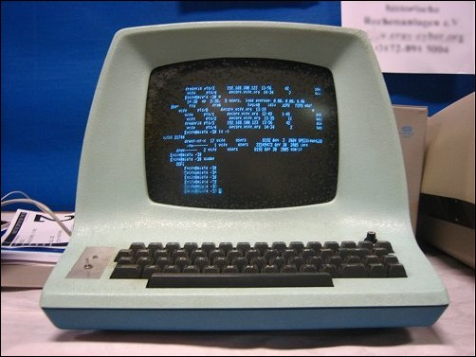

Slide 5
The browser is a terminal.
Terminals allow us to perceive and comprehend data.
Recently it also allows us to interact with it.

Slide 6


Slide 7


Slide 8


Slide 9


Slide 10
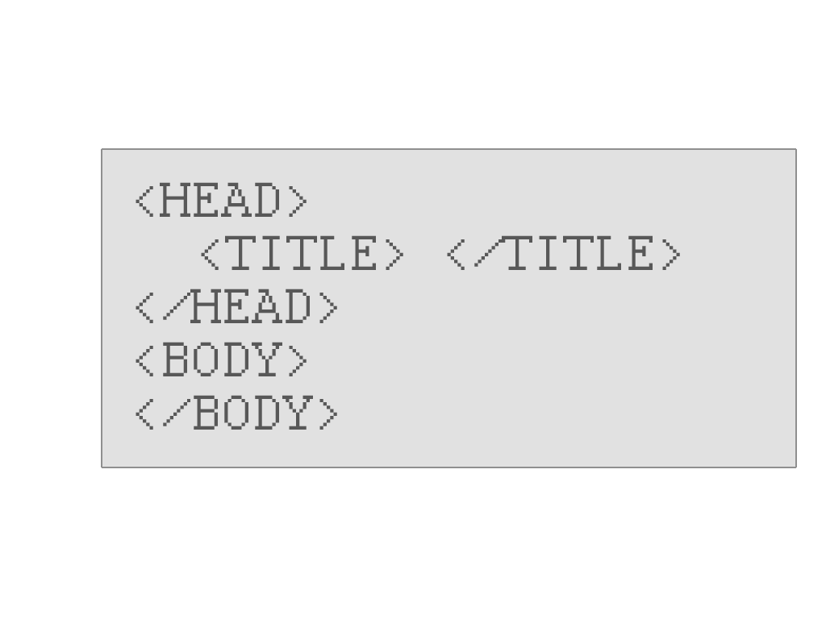

Slide 12
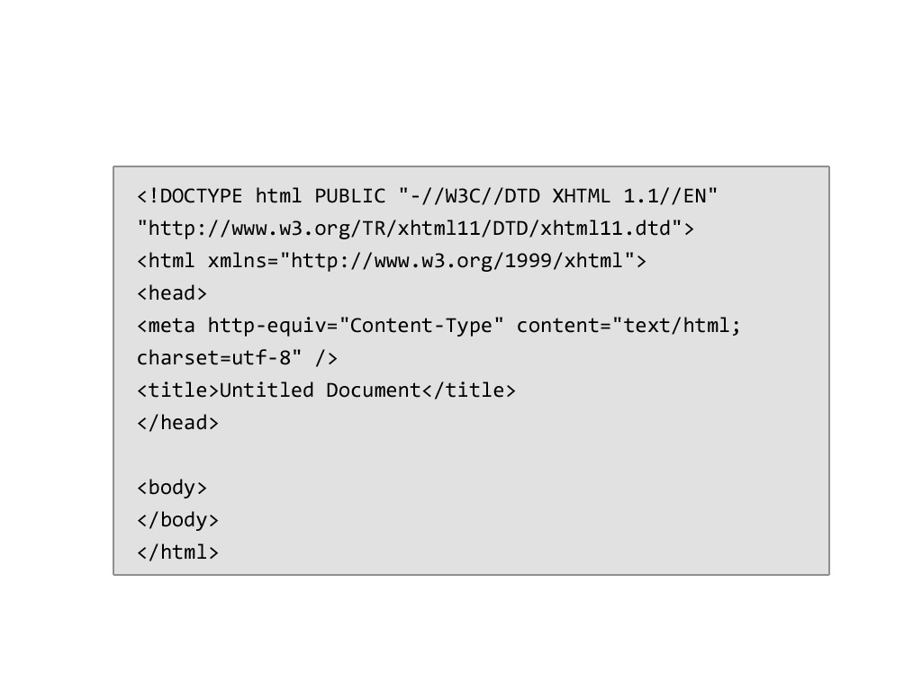
XHTML 1.0 Doctype

Slide 13
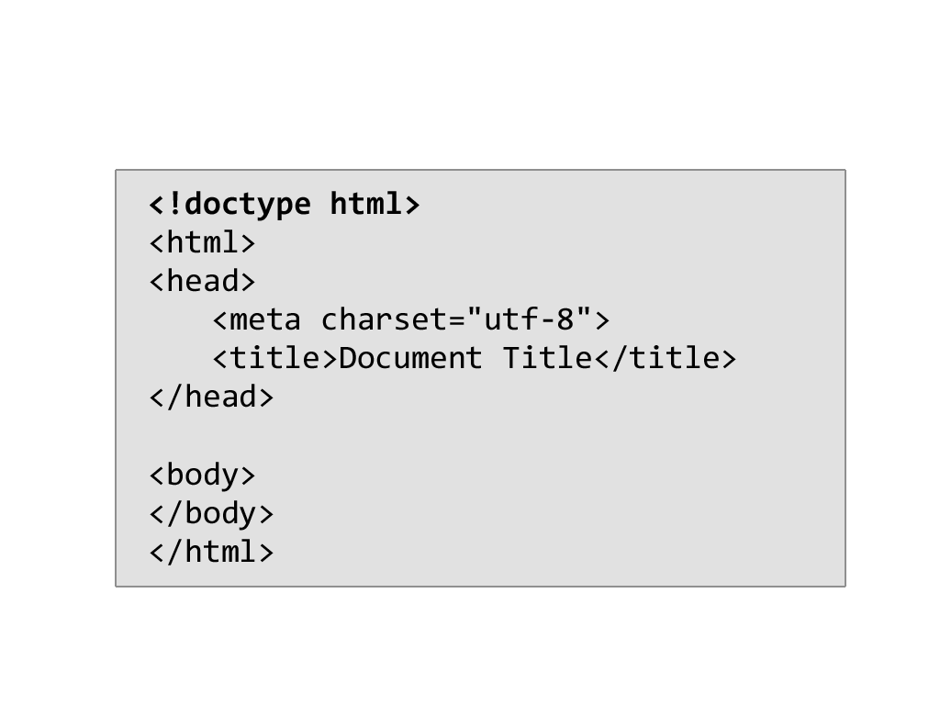
HTML5 Doctype

Slide 14
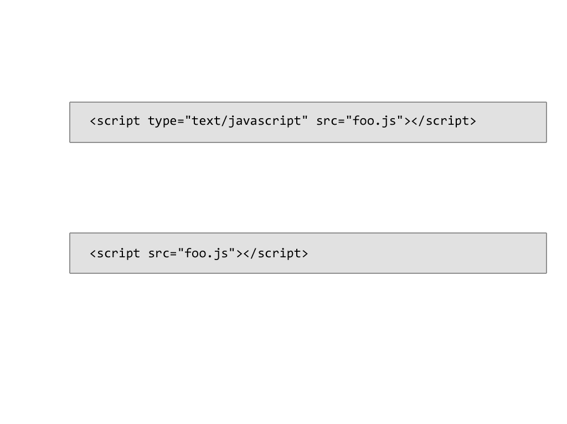
Simpler attributes
No need for type attributes

Slide 15
HTML5 focuses on
semantics and functionality.

Slide 16
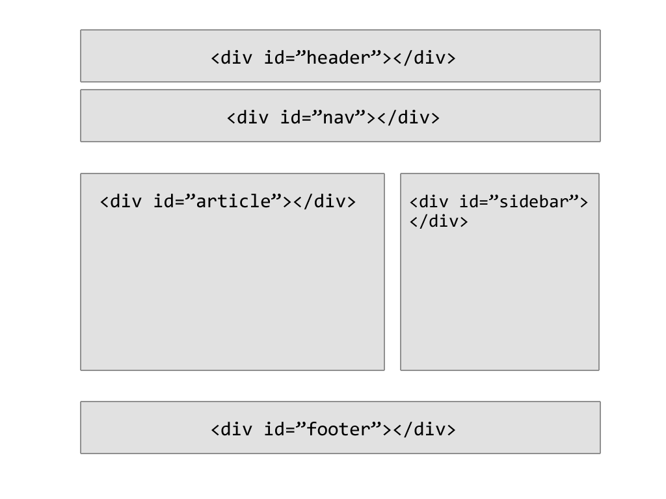

Slide 17



Slide 18
What everyone’s asking:
Does it matter if I use it?
What tags can I use?
When do I use it?

Slide 19
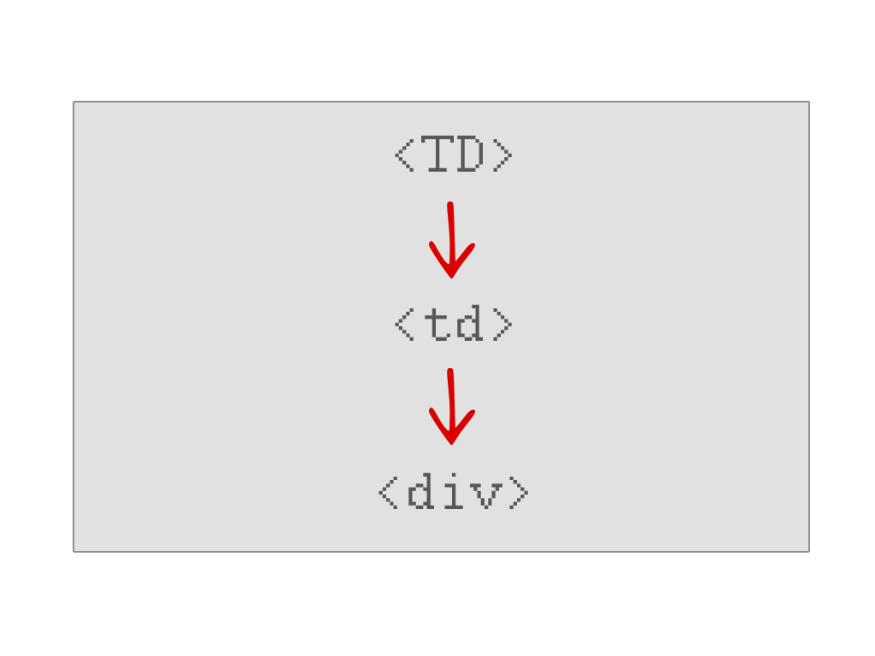

Slide 20
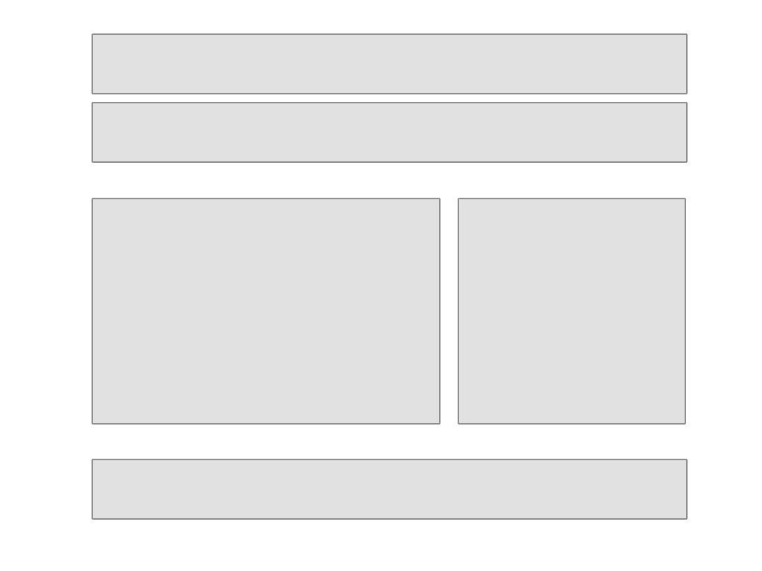

Slide 21


Slide 22
YES!

Slide 23
10 Reasons why you should be
Using HTML5 right now.
10. Accessibility
9. Video and Audio support
8. Doctype
7. Cleaner code
6. Smarter storage

Slide 24
10 Reasons why you should be
Using HTML5 right now.
Interactivity
4. Game development
Legacy support
2. Mobile/iPad support

Slide 25


Slide 28
Some HTML5 tags
<header>
<hgroup>
<nav>
<footer>
<article>
<aside>
<section>
<figure>
<audio>
<video>
Form fields
...etc

Slide 29
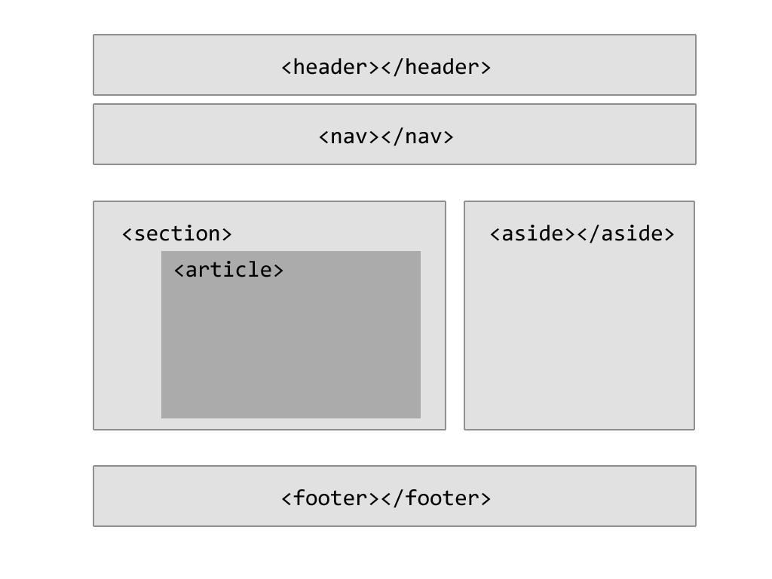

Slide 30

BUT WAIT!!!!
What happens when
People using
view my webpage??

Slide 31
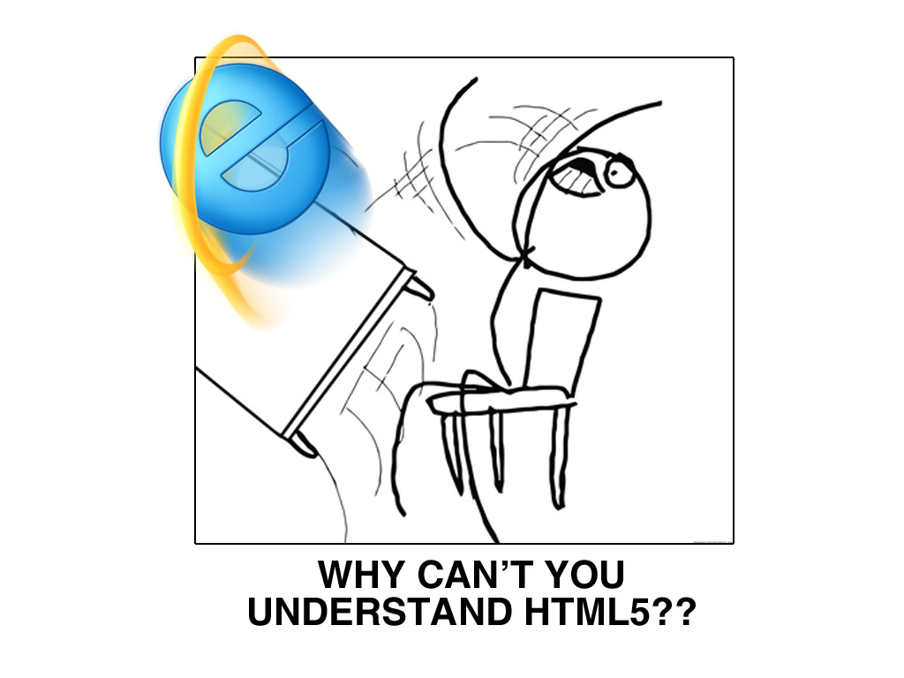

Slide 32
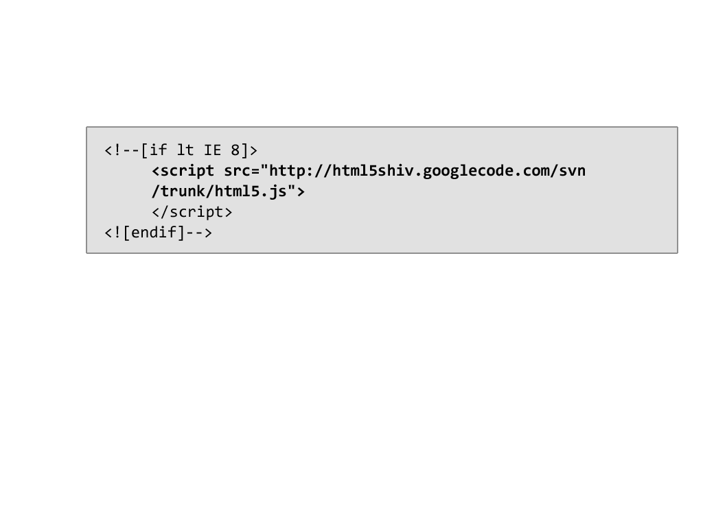

Use conditional HTML5
Compatibility methods
Or use the more advanced:
http://modernizer.com

Slide 33


Slide 34
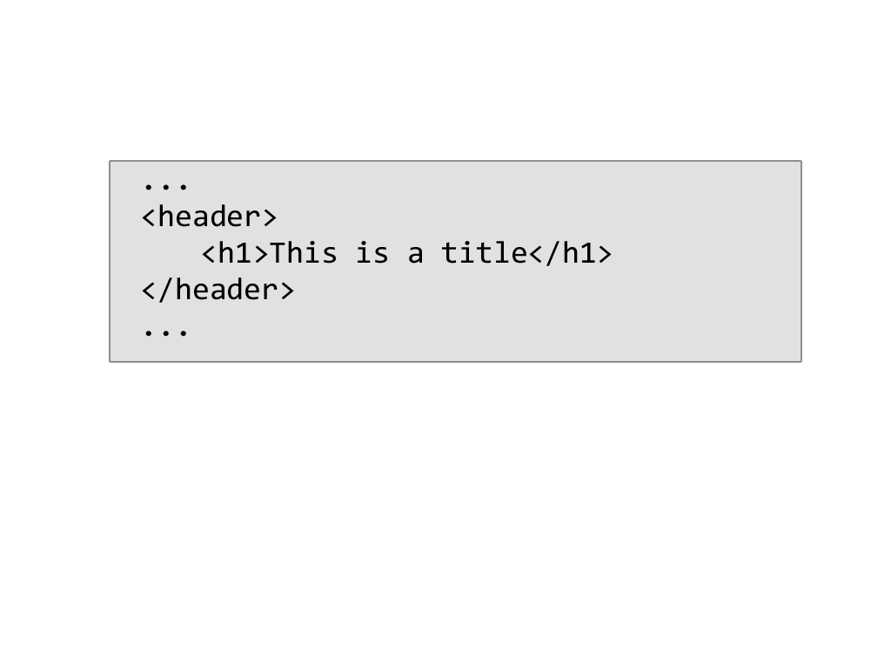
<header> element

Slide 35
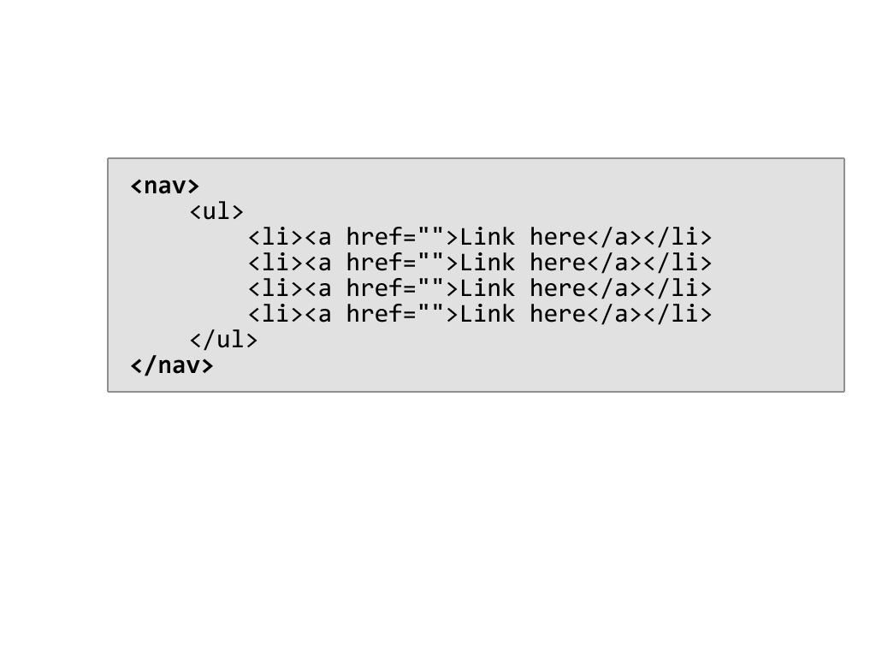
<nav> element

Slide 36

<footer> element

Slide 37
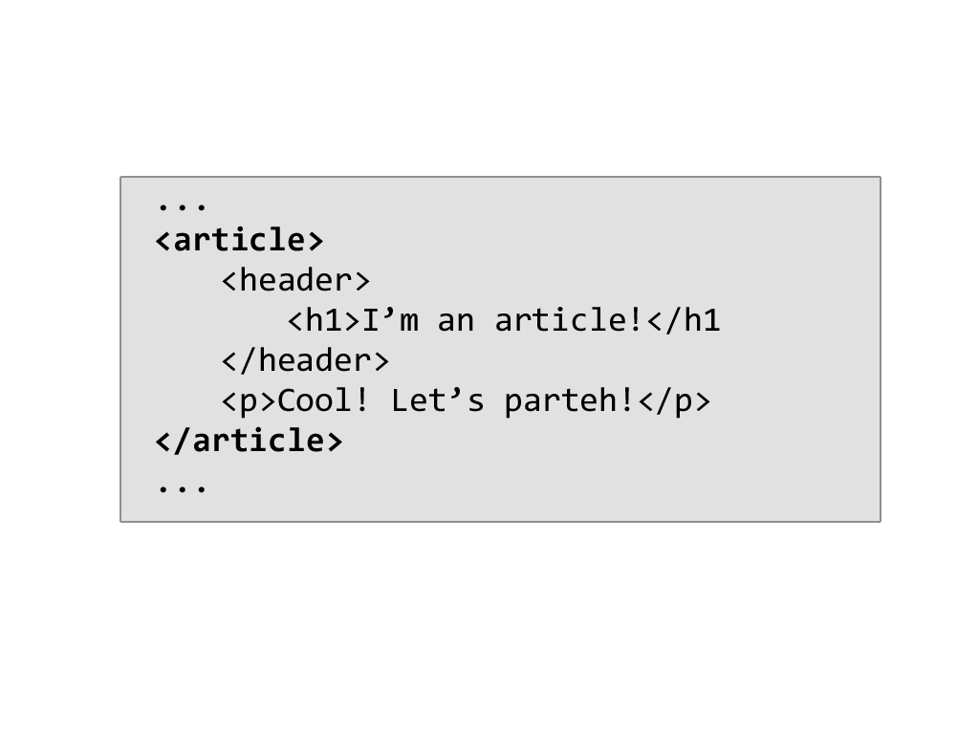
<article> element

Slide 38
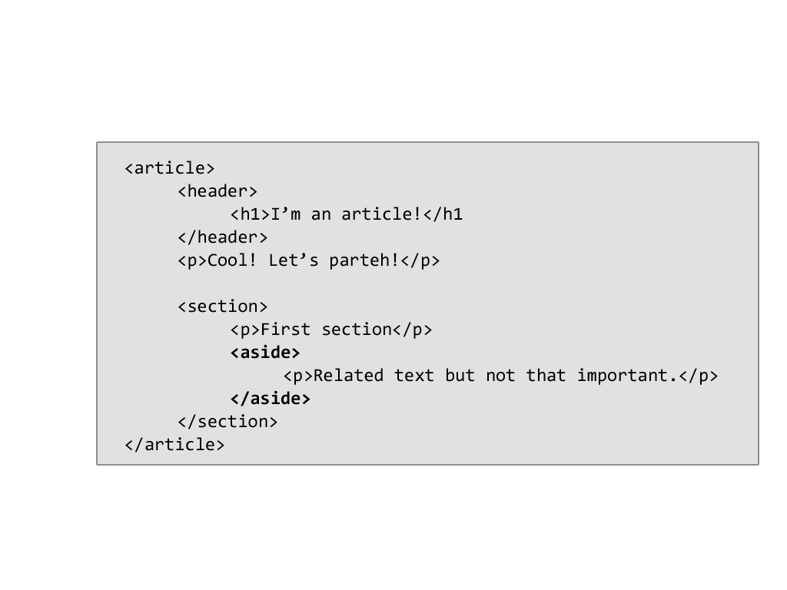
<aside> element

Slide 40
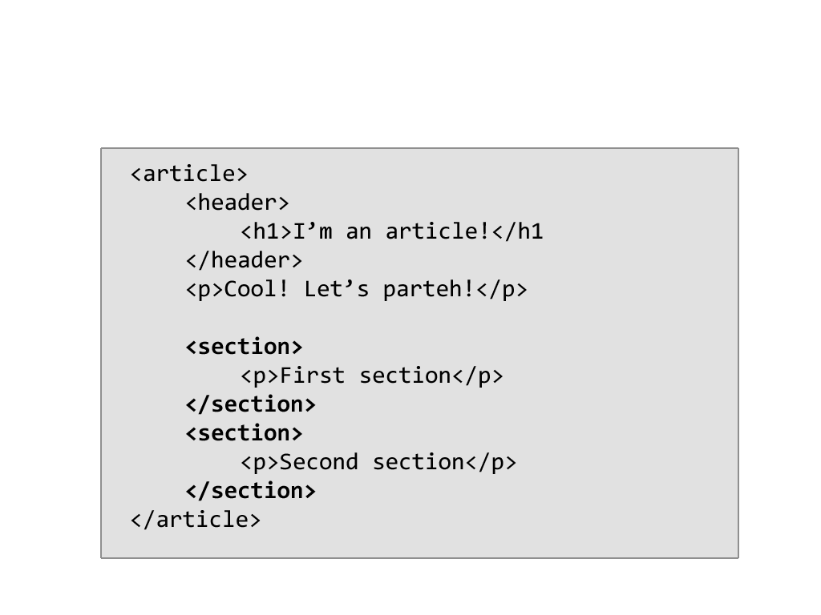
<section> element

Slide 41
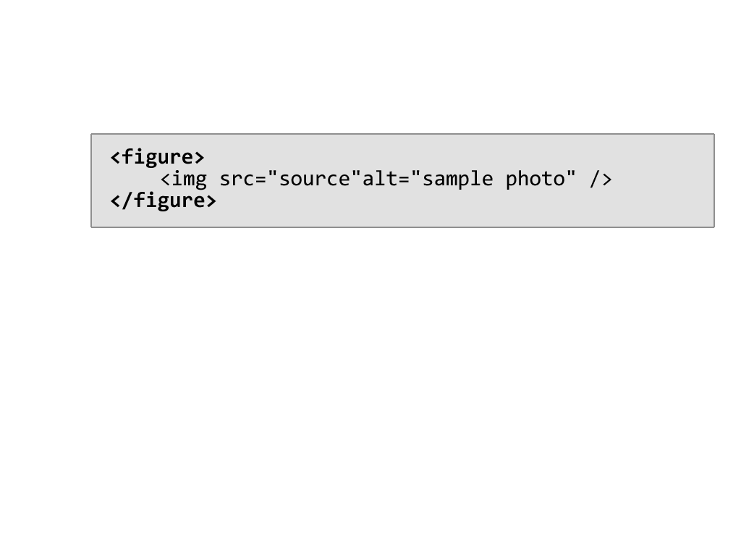
<figure> element

Slide 42
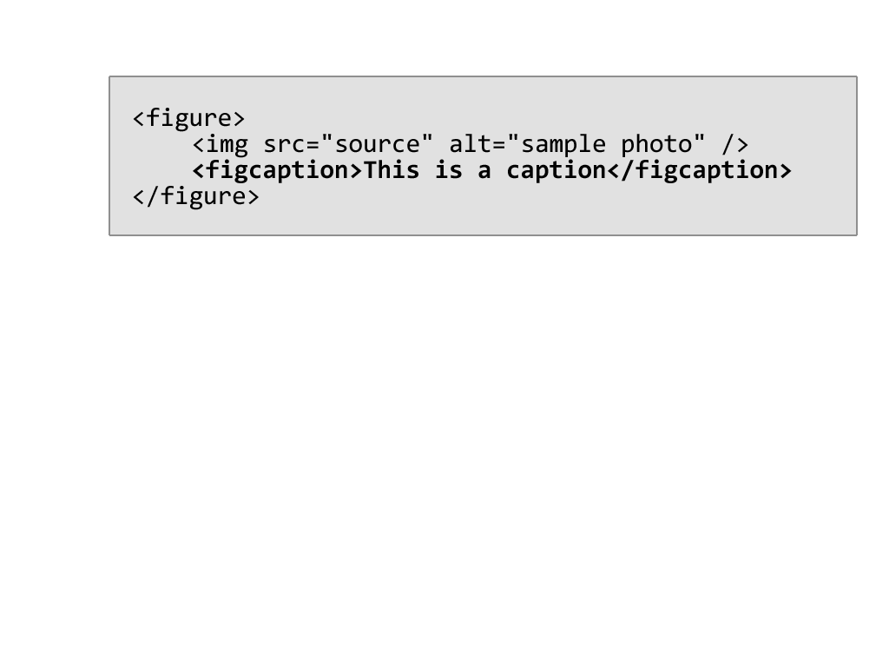
<figcaption> element

Slide 43
Fun with HTML5 forms
HTML5 comes packaged with new
form elements for more detailed
development and validation.

Slide 44
New HTML5 Fields
Tel
Search
url
Email
Datetime
Date
month
Week
Time
Datetime-local
Number
Range
color

Slide 45
New HTML5 Attributes
autofocus
placeholder
form
required
autocomplete
Pattern
dirname
dirname
novalidate
formaction
formenctype
formmethod
formnovalidate
formtarget

Slide 47
What bothers you the most
when coding CSS 2.1?
Decorative images
Markup clutter
Javascript for show

Slide 48
Most used CSS3 rules
rgba(good) and hsla (better)
border-radius
background
box-shadow
text-shadow (no IE)
:nth-child, :nth-last-child, etc.

Slide 49
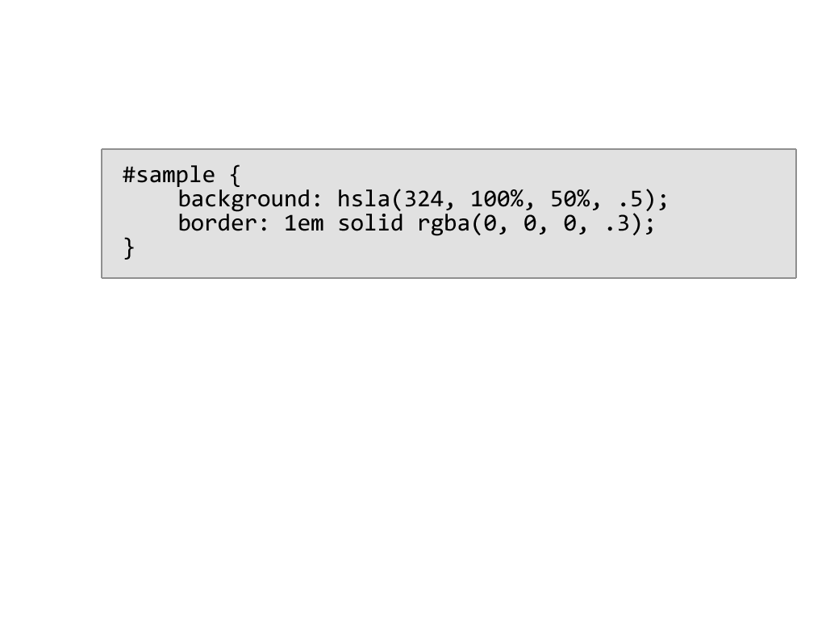

hsla(), rgba() CSS3

Slide 50
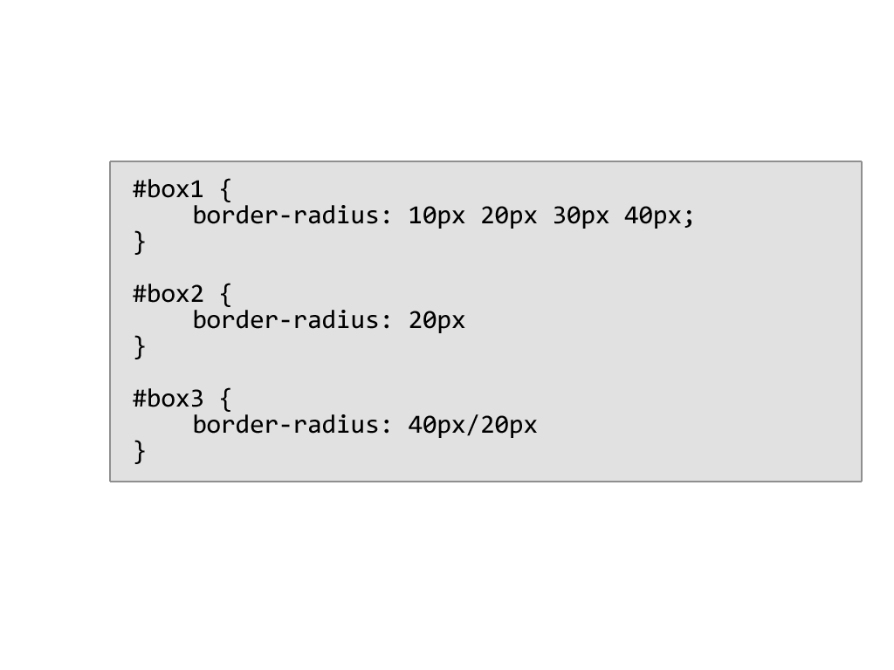

border-radius CSS3

Slide 51
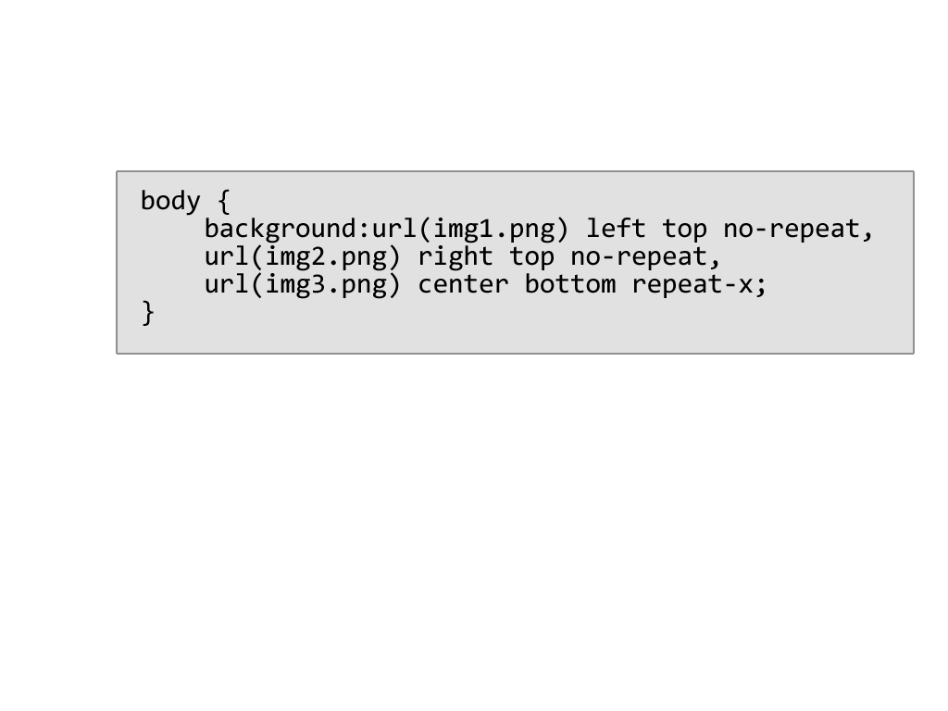
background CSS3

Slide 52
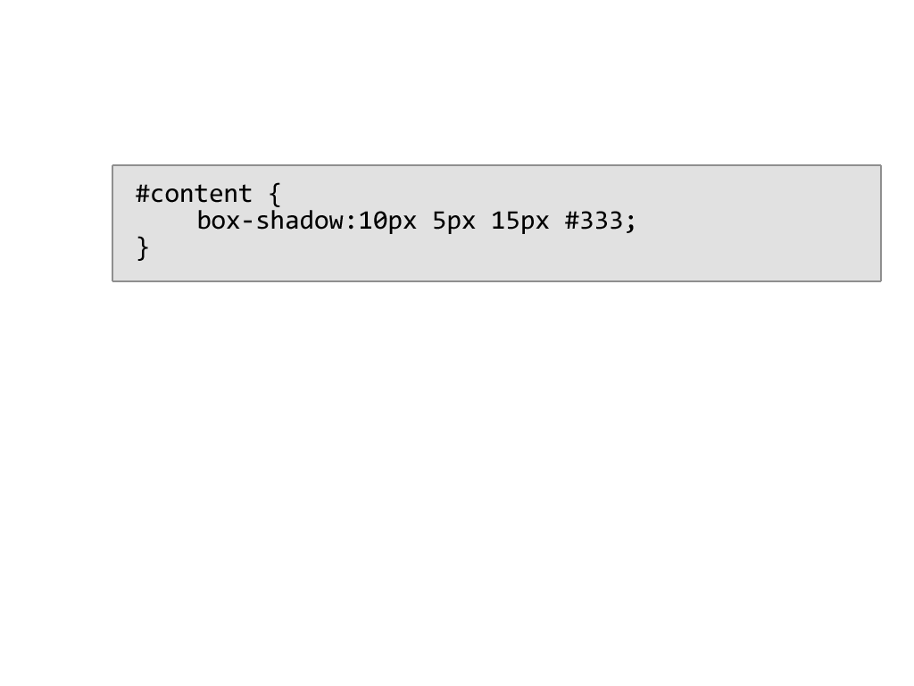

box-shadow CSS3

Slide 53
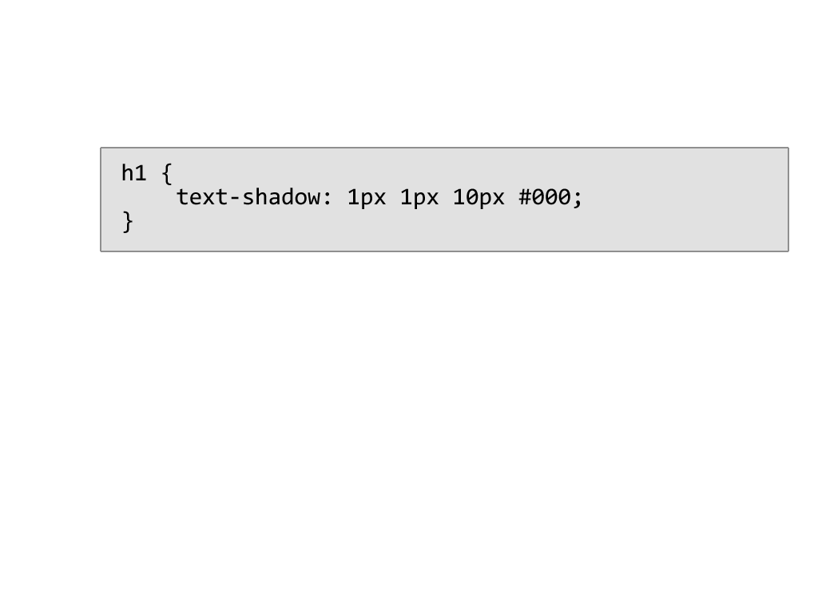

text-shadow CSS3

Slide 54
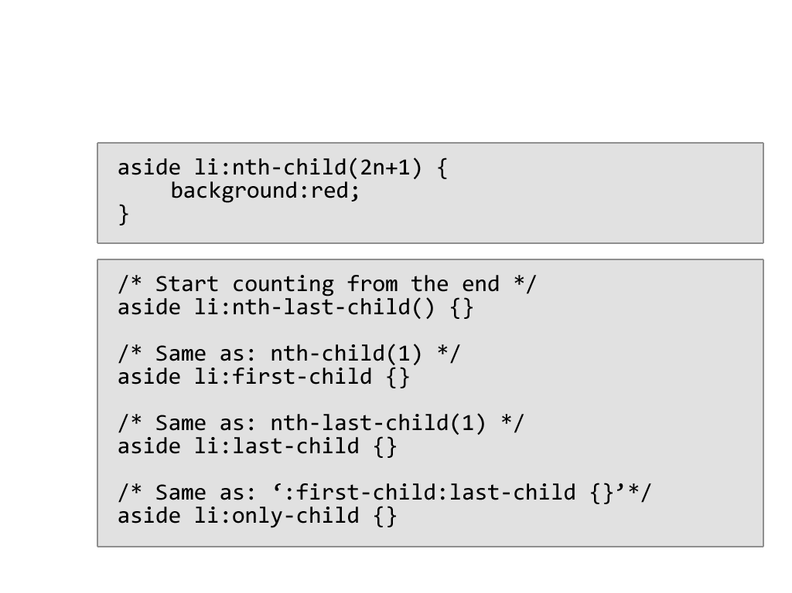
:nth-child CSS3

Slide 55

IMPACT IT Short Courses:
Wordpress Theme Development
Wordpress as CMS email me: john@johnimbong.com

Slide 56
Thank You!

